Slide 1
A project seminar on “Automatic control of fan speed using fuzzy logic”
Students:
M.Pragati(1RN16CS044)
K.L.Poojitha(1RN16CS038)

Slide 2
CONTENTS
ABSTRACT
INTRODUCTION TO FUZZY LOGIC
INPUT STAGE (FUZZIFICATION)
PROCESSING STAGE (RULE BLOCK)
OUTPUT STAGE(DEFUZZIFICATION)

Slide 3
ABSTRACT
This provides a clear view of how speed control is done based on the data from the temperature sensor using fuzzy logic. In this ,we use data from analysis and verify it with different mathematical formulas. In this project , the input is taken in fuzzified form and converted into a defuzzified value to get a crisp output by following certain rule blocks. In mythological analysis we consider 3 stages ,Fuzzification of Input , defining rule block and Defuzzification , to get the output.

Slide 4
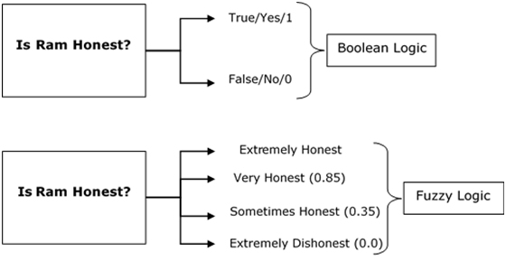
INTRODUCTION
FUZZY LOGIC : We are familiar with Boolean logic which consists of only either TRUE (degree of truth=1) and FALSE(degree of truth=0). Whereas in fuzzy logic, we deal with cases which are partially true or partially false.
The truth values of variables may be any real numbers between 0 and 1. It is employed to handle the concept of partial truth, where the truth value may range between completely true(degree of truth=1) and completely false(degree of truth = 0).

Slide 5
Why Fuzzy Logic?
Fuzzy logic is useful for commercial and practical purposes.
It can control machines and consumer products.
It may not give accurate reasoning, but acceptable reasoning.
Fuzzy logic helps to deal with the uncertainty in engineering.

Slide 6
Algorithm:
Define linguistic variables(Linguistic variables are input and output variables in the form of simple words or sentences. For room temperature, cold, warm, hot, etc., are linguistic terms) .
Construct membership functions for them.
Construct rules.
Convert crisp data into fuzzy data sets using membership functions.
Evaluate rules in the rule base.
Combine results from each rule.
Convert output data into non-fuzzy values.

Slide 7
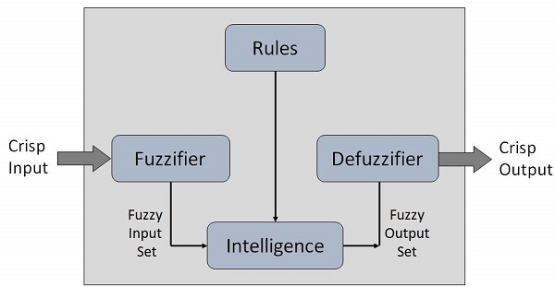
Overall working:

Slide 8
FUZZIFICATION
For simplicity of the design, the fuzzy controller receives a single input (i.e., ambient temperature) and generates a single output (i.e., speed of the fan).There are five triangular membership functions for the temperature input . The range of the temperature is from 0 to 40◦C. These are termed as: very cold (0–10), cold (0–20), warm (10-30), hot (20-40) and very hot(30-40).
We construct member functions for these variables.
Fuzzification gives us the truth degrees for the particular inputs.

Slide 9
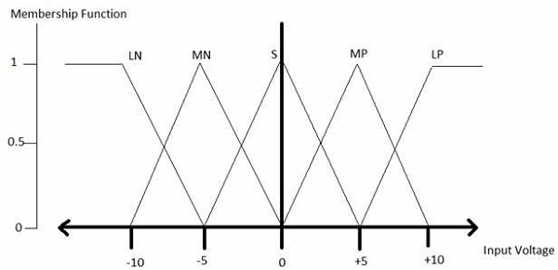
Membership function:
Membership functions allow you to quantify linguistic term and represent a fuzzy set graphically.
Here, the variables are mapped to a value between 0 and 1. It is called membership value or degree of membership(the degree of truth).
x axis represents the universe of discourse*.
y axis represents the degrees of membership in the [0, 1] interval(the degree of truth).
Term 3
Term 4
Term 1
Term 2
Term 5
UoD
*universe of discourse:
the complete range of objects, events, attributes, relations, ideas, etc., that are expressed, assumed, or implied in a discussion.

Slide 10
Term 3
Term 3
Term 1
Term 2
Term 4
Term 5
Term 4
Term 5
UoD
Term 1
UoD
The triangular membership function shapes are most common among various other membership function shapes such as trapezoidal, singleton, and Gaussian.

Slide 11
INPUT GRAPH
Very cold
cold
warm
hot
Very hot
Membership function
Temperature

Slide 12
Truth degree for a triangular membership function can be given by:
Where, a= lower limit , b=upper limit ,m is a<m<b
Truth degree= 0, x<=a
(x-a)/(m-a),a<x<=m
(b-x)/(b-m),m<x<b
0,x>=b
Where , x=input temperature

Slide 13
RULE BLOCK
In fuzzy logic ,rules are set up to take control of the output. The rules in fuzzy logic are simple with an if-then condition ,having a condition and the target .
If (temperature is very cold) then (speed is zero)
If (temperature is cold) then (speed is slow)
If (temperature is warm) then (speed is medium)
If(temperature is hot) then (speed is fast)
If (temperature is very hot) then (speed is very fast)

Slide 14
OUTPUT GRAPH
zero
Membership functions
Speed of the fan in RPM

Slide 15
DEFUZZIFICATION
The process of getting output based on rule block is DEFUZZIFICATION.
Defuzzification is interpreting the membership degrees of the fuzzy sets into a specific decision or real value.
It gives us the crisp output(i.e., the speed in RPM).
Defuzzification can be achieved in many ways.
One of the ways used here is the weighted average method for defuzzification.
Z* = (a(truth degree1)+b(truth degree2))/(truth degree1+truth degree2)
Where a and b are the centroids of the output triangular member function.
Here , Z* gives us the crisp output.

Slide 16
Application Areas of Fuzzy Logic
The key application areas of fuzzy logic are as given −
Automotive Systems
Automatic Gearboxes
Four-Wheel Steering
Vehicle environment control
Domestic Goods
Microwave Ovens
Refrigerators
Toasters
Vacuum Cleaners
Washing Machines
Environment Control
Air Conditioners/Dryers/Heaters

Slide 17
Advantages:
Mathematical concepts within fuzzy reasoning are very simple.
Fuzzy logic Systems can take imprecise, distorted input information.
FLSs are easy to construct and understand.
Fuzzy logic is a solution to complex problems in all fields of life, including medicine, as it resembles human reasoning and decision making.

Slide 18
Disadvantages:
There is no systematic approach to fuzzy system designing.
They are suitable for the problems which do not need high accuracy.

Slide 19
THANK YOU

